Slide 1

Developing Straits Times’
Predictive Advertisements using Analytics
TEAM 3 S04
KOH I-ZACH (U2010476G)
POH SING YONG SHERLYN (U2011571H)
ROSHAN THAPA (U2022199F)
SNG YI XUAN (U2021009B

Slide 2

Agenda
Case Justification
Introduction to business problem
01
02
Data Cleaning
Data Exploration
03
04

Slide 3
Agenda
Analytics Solution
Implementation Strategy
05
06
07
Evaluation
08
Conclusion

Slide 4
01
Introduction to Business Problem

Slide 5


Google Ads on Straits Times
I-Zach
Based off past search history
and cookies from google
Google takes a 32%-49% cut from
Straits Times for every click

Slide 6

Ban of tracking cookies
I-Zach
Google will ban tracking cookies from 2023 onward
-
Predictive algorithm by Google Ads for advertisers may not be as effective
Straits times users will not receive ads that are as targeted as before

Slide 7
Business Problem
I-Zach
Removal of tracking cookies brews much uncertainty over the effectiveness of Google Ads in the future
Google currently takes a large portion of the commission fee generated when a customer clicks on an ad, thereby cannibalising on Straits Times’ ad revenue

Slide 8
Our Solution
I-Zach
We want to create a predictive model that equips Straits Times with a decision-making tool which enables them to decide who they should target the advertisement to, with the ultimate goal of increasing click-through rate

Slide 9
02
Case Justification

Slide 10
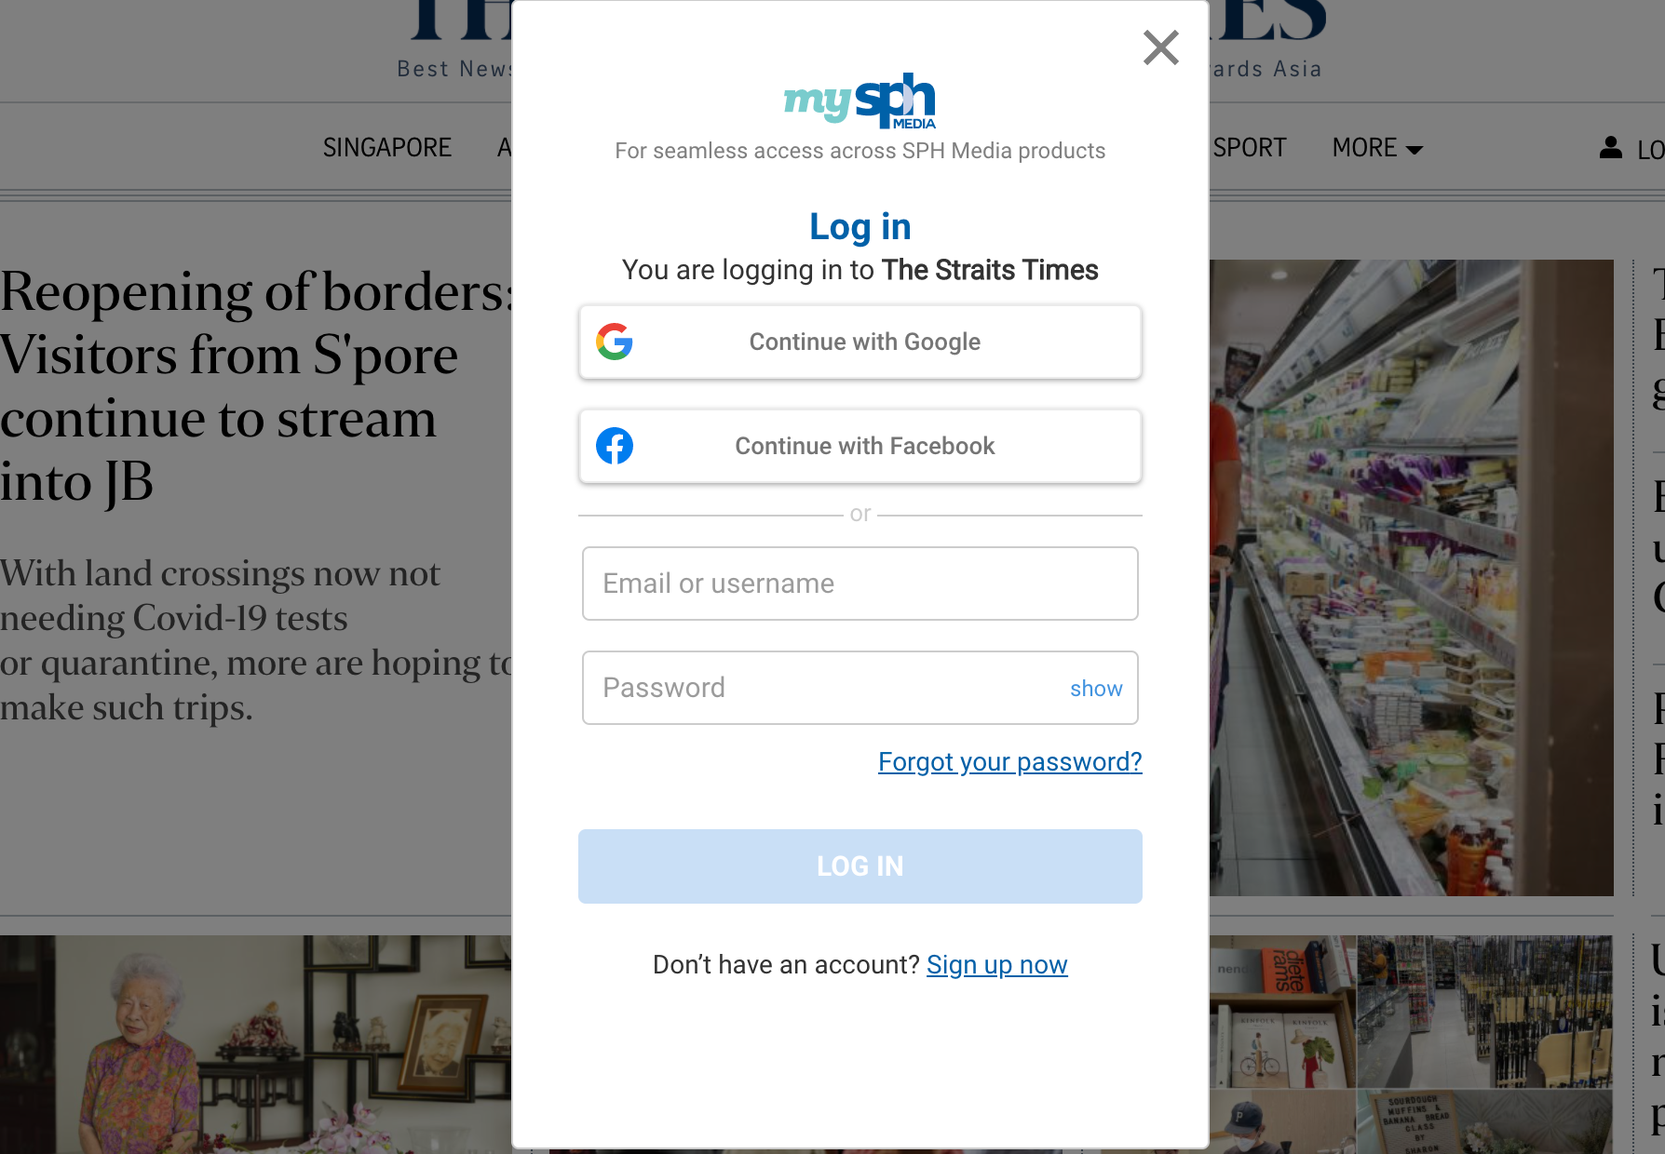
Why Straits Times?
I-Zach
Customer Login information
Data on past articles read
Falling ad revenue
-

Slide 11
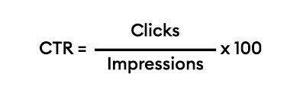
Value of Predictive Model
I-Zach
Increased click-through rates through more accurate targeting of customers
Benefits of predictive analytical models to clients
Competitive Advantage

Slide 12

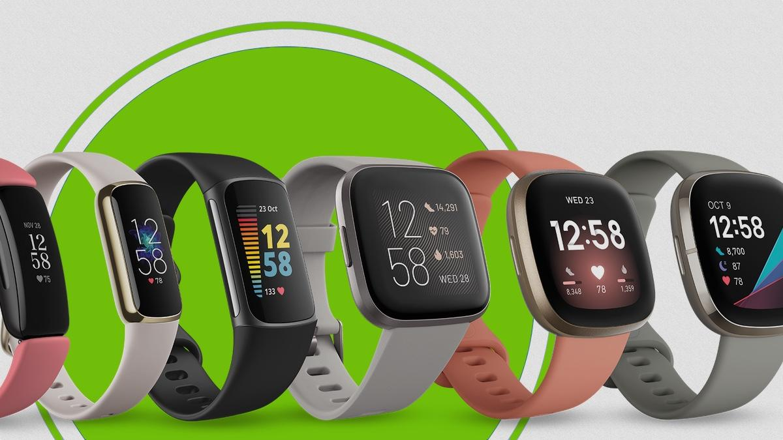
Fitbit
I-Zach
An American consumer electronics and fitness company
Mainly in the business of smartwatches

Slide 13
Variables of Interest
I-Zach
We can utilise certain variables that would be important in prediction for Fitbit
Higher number of articles read on Technology and Health are likely to be strong predictors for smartwatch interest

Slide 14
03
Data Cleaning

Slide 15
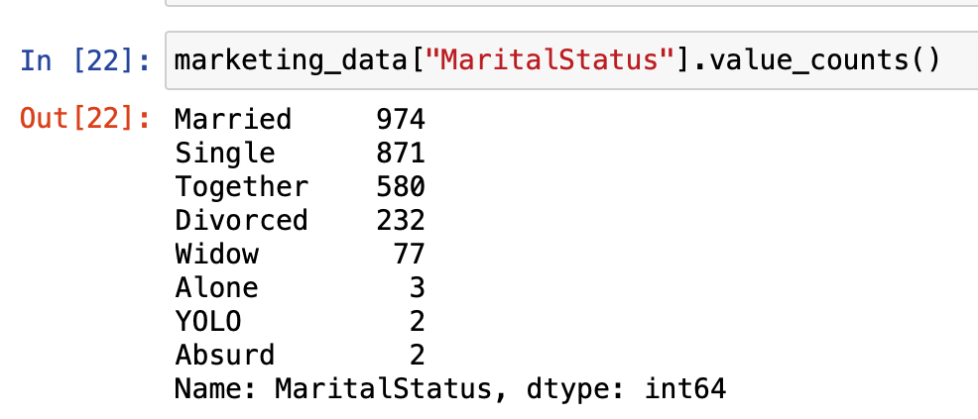
Categorical Variables
I-Zach
We used logical reasoning to replace wrong data entries

Slide 16
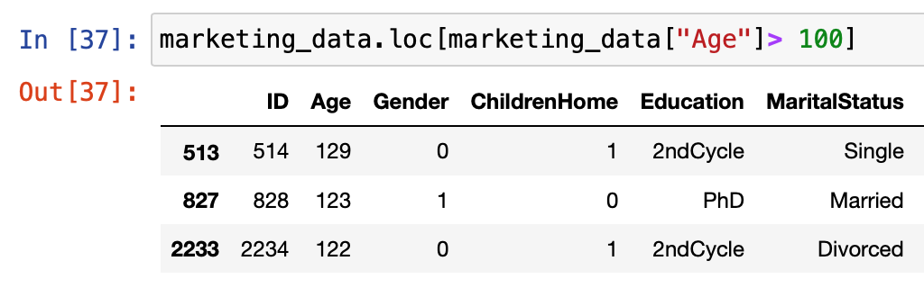
Continuous Variables
I-Zach
Used averages to replace continuous variables that had the wrong entry

Slide 17
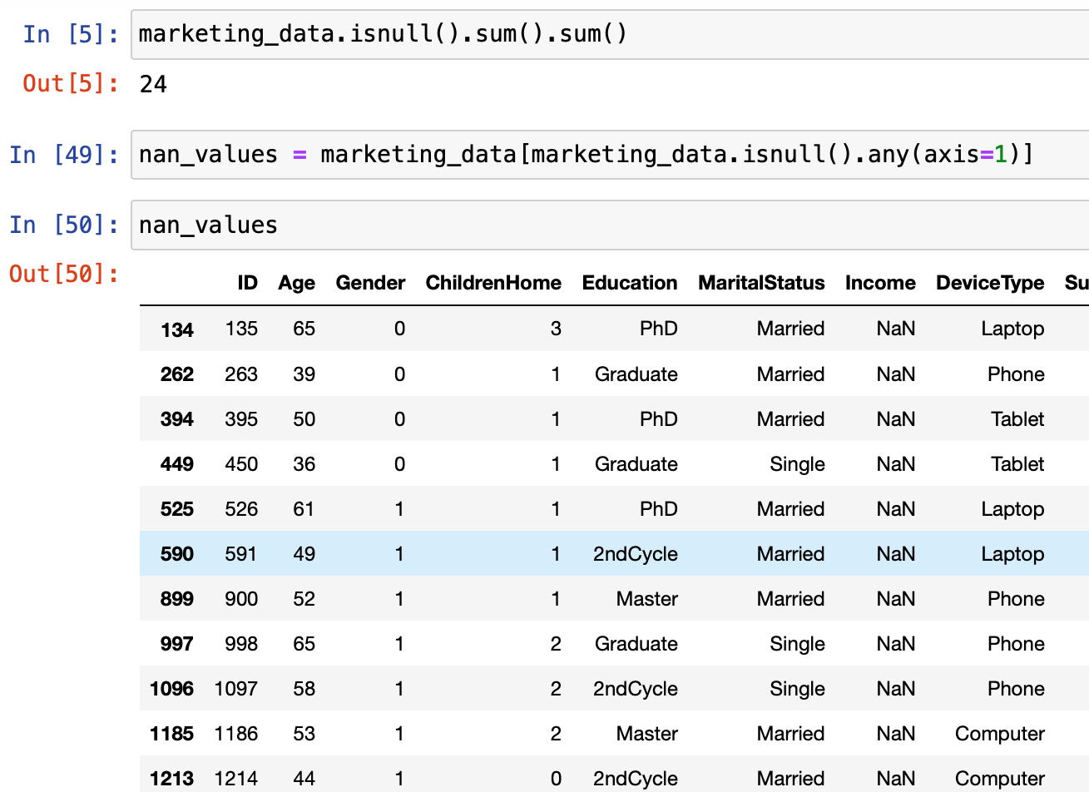
NA Values
I-Zach
Replaced NA values with the median based on other variables

Slide 18
04
Data Exploration
How do the individual variables affect click response?

Slide 19
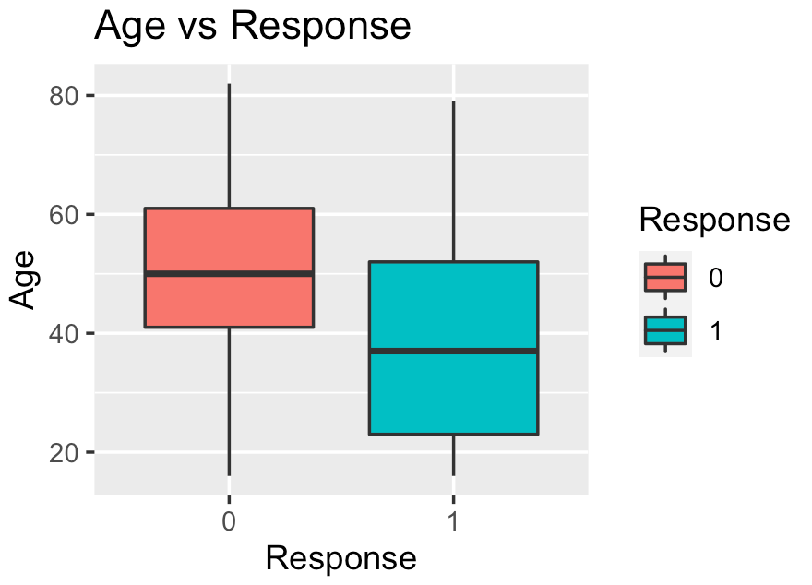
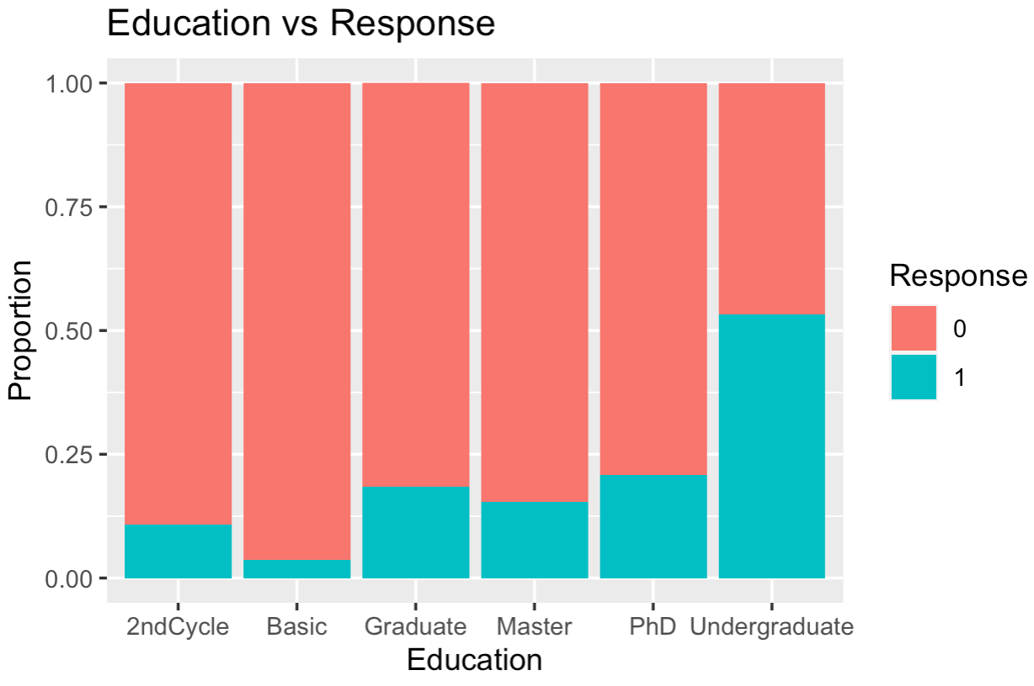
Personal Information
Roshan
Younger users more likely to click
Undergraduates most likely to click

Slide 20
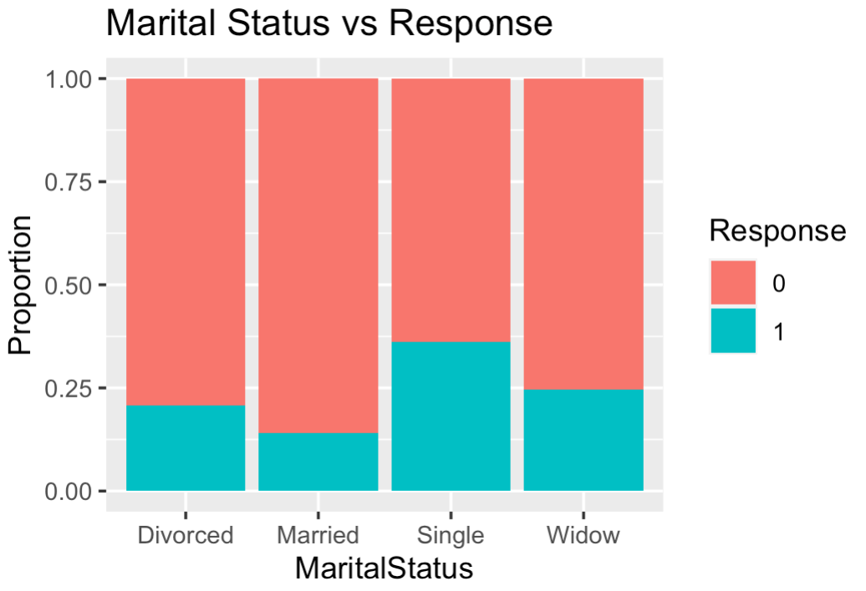
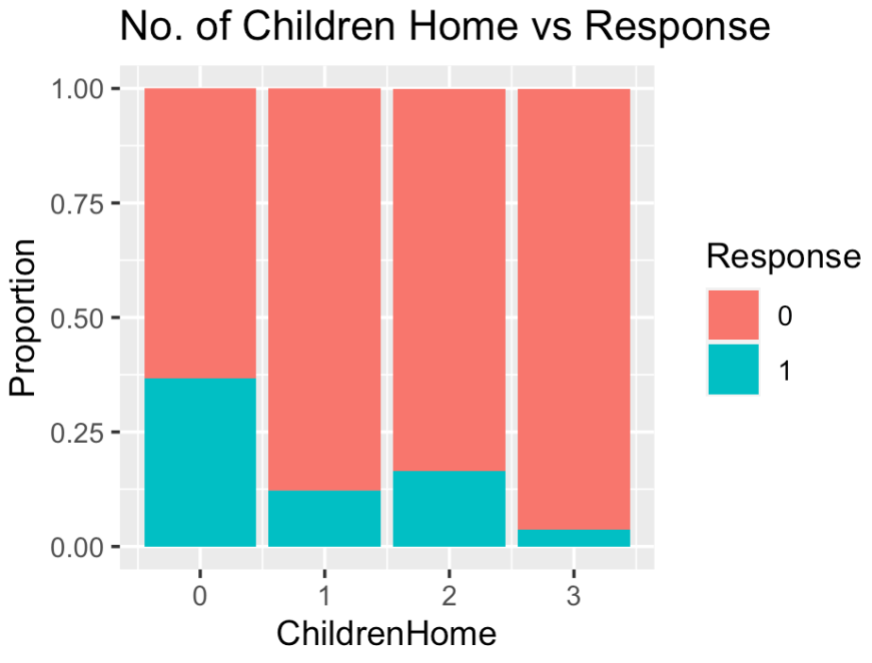
Personal Information
Roshan
Single users most likely to click
Users with 0 children most likely to click

Slide 21
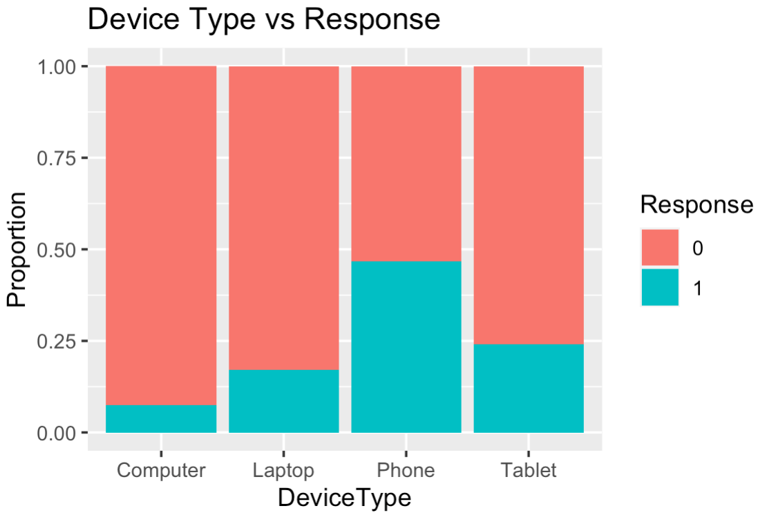
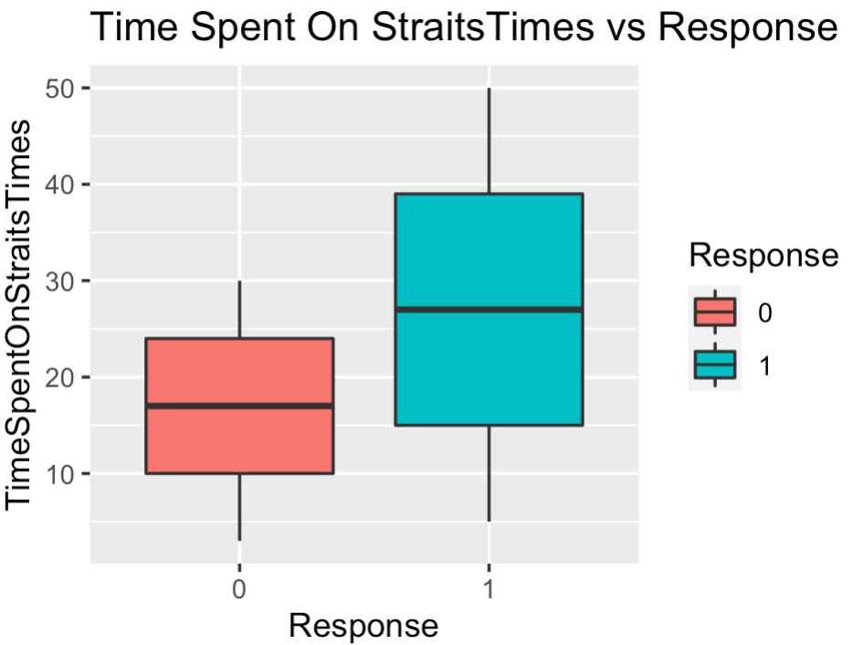
Online activity of users
Roshan
People who used Straits Times on phone are most likely to click
Users who spend more time on Straits Times are more likely to click

Slide 22
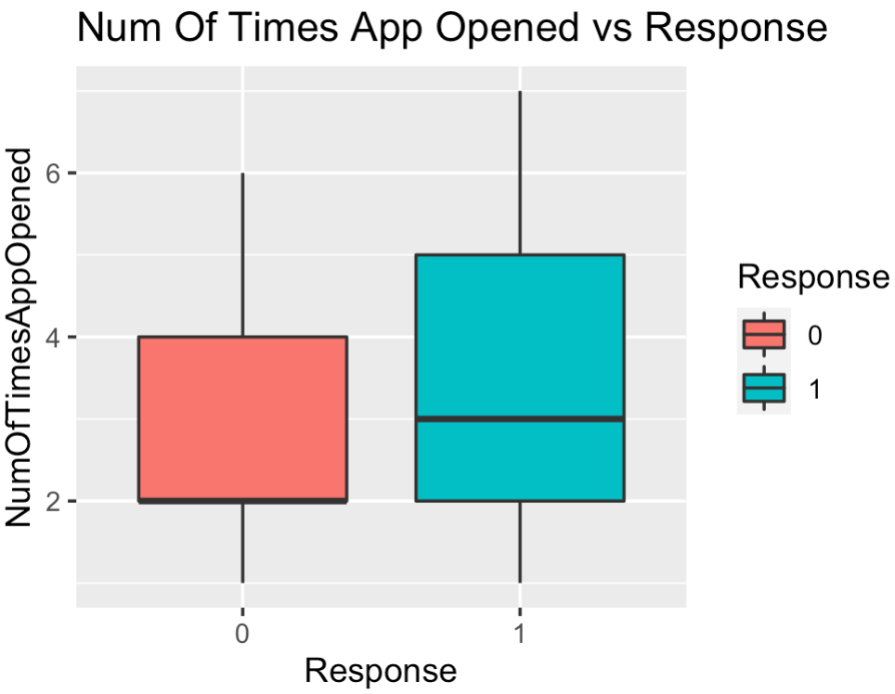
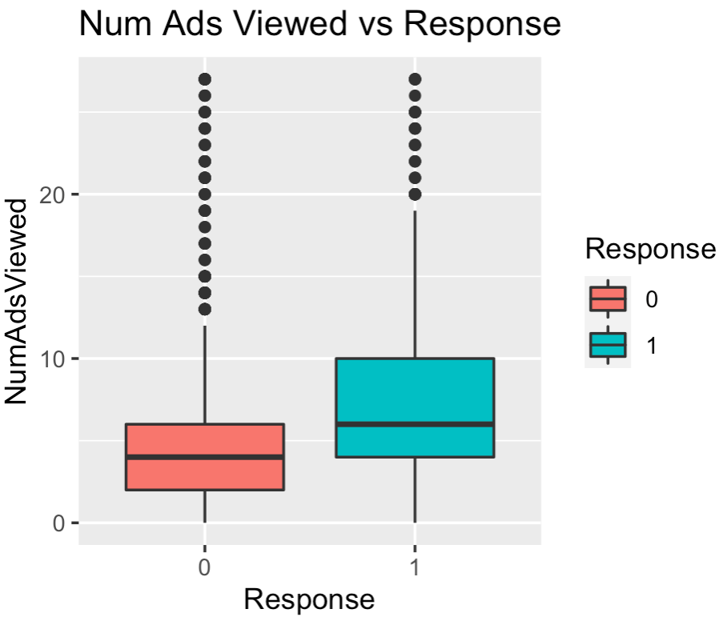
Online activity of users
Roshan
People who opened Straits Times more are more likely to click
Users who viewed more ads are more likely to click

Slide 23
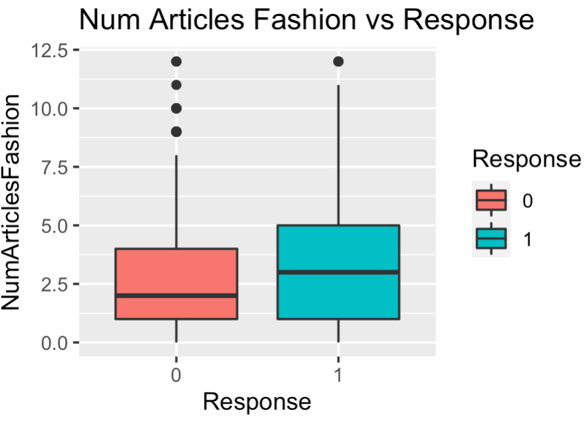
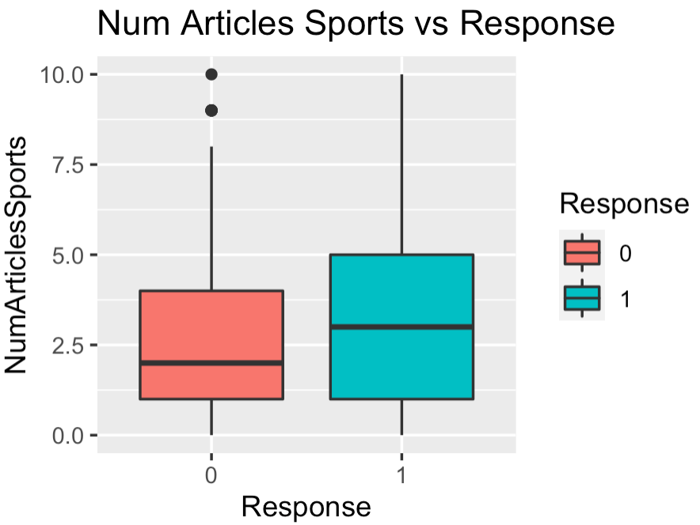
Number of articles read
Roshan
Users who read more articles related to fashion and sports are more likely to click

Slide 24
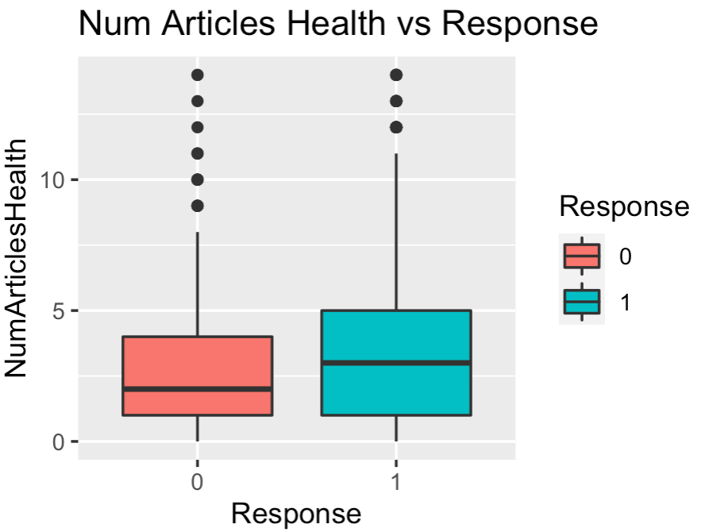
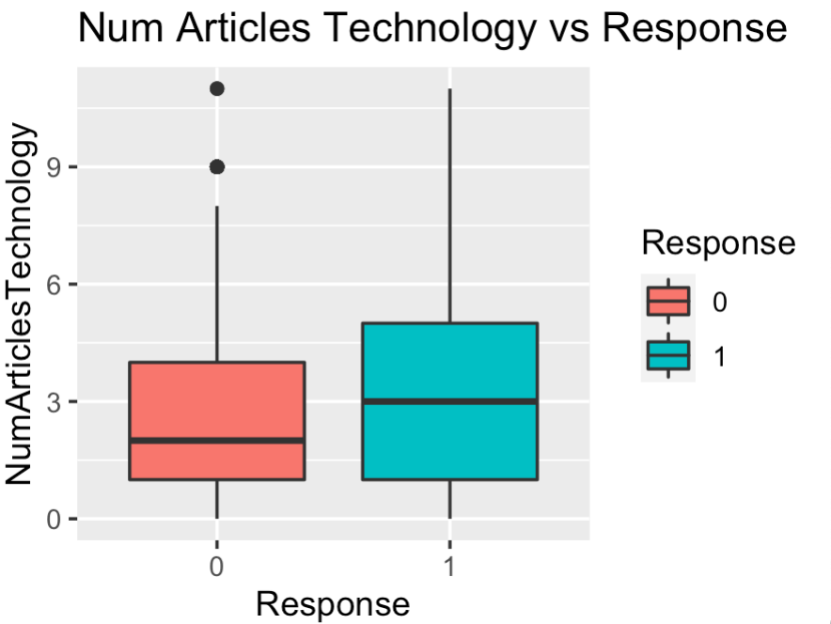
Number of articles read
Roshan
Users who read more articles related to health and technology are more likely to click

Slide 25
05
Analytics Solution
Determining the optimal model

Slide 26
Approach
Sherlyn
Building the optimal analytical model with past data of ST’s readers and their response to advertisements
Steps taken to build optimal analytical model:
Perform association rule analysis to understand association between input variables and response
Training models on balanced and unbalanced trainset
Test the model
Plot confusion matrix and obtain error rates (FPR, FNR, classification error)
Compare results
Evaluate model

Slide 27
Association Rules
5.2

Slide 28
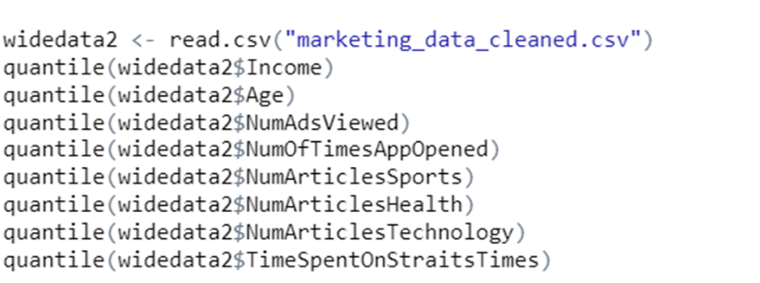
Data Preparation
Sherlyn
Converting continuous variables to categorical variables
Divide the continuous data points into 4 quartiles
Converting data into transaction data format

Slide 29
Association Rules
Sherlyn
Rules | Support | Confidence | Lift
{Education=Undergraduate,DeviceType=Tablet, Incomelvl=1,Timespentlvl=4} => {Response=1} | 0.01131 | 0.91176 | 4.1583
{DeviceType=Phone,OpenApplvl=4,Timespentlvl=4} => {Response=1} | 0.024444 | 0.85897 | 3.9176
{ChildrenHome=0,DeviceType=Phone,Timespentlvl=4} => {Response=1} | 0.029186 | 0.80000 | 3.6486
{DeviceType=Phone,Techlvl=4,Timespentlvl=4} => {Response=1} | 0.017147 | 0.85455 | 3.8974
{ChildrenHome=0,DeviceType=Phone,OpenApplvl=4,Timespentlvl=4} => {Response=1} | 0.013864 | 0.90476 | 4.1264
Strong predictors of users response to ad
Time spent on straits times
Number of Times app was opened
Device type=Phone

Slide 30
Logistic Regression (BE)
5.3

Slide 31
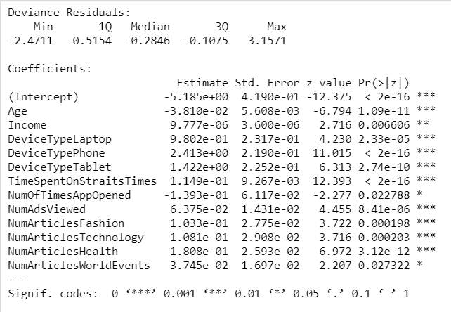
Method
Sherlyn
Logistic Regression is used to explain the relationship between categorical variable response and it’s independent X variables
Perform logistic regression on balanced and unbalanced dataset
Backward elimination used to remove statistically insignificant independent variables to obtain lowest AIC value

Slide 32
Statistical significance
Unbalanced Trainset
Balanced Trainset
Sherlyn
Age
Device type
Time spent on ST
Number of ads viewed
Number of articles read relating to fashion
Number of articles read relating to technology
Number of articles read relating to health
Age
Device type
Time spent on ST
Number of ads viewed
Number of articles read relating to health
Notes:
Most statistically significant variables from analysis on unbalanced and balanced trainset
Category of articles read chosen due to relevance to fitbit/ what they would be interested to know

Slide 33
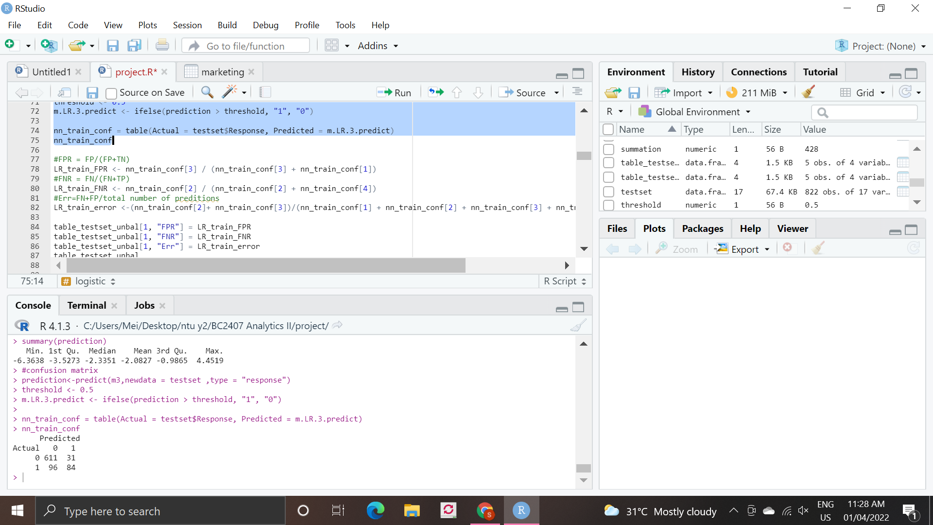
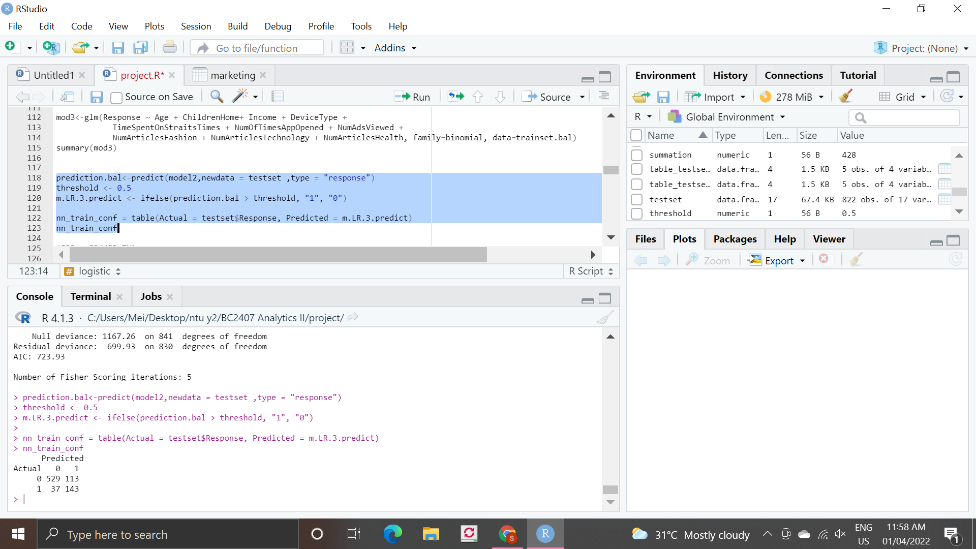
Confusion matrix and errors
Unbalanced Trainset
Balanced Trainset
Sherlyn
Dataset | FPR | FNR | Err
Unbalanced | 0.048 | 0.533 | 0.154
Balanced | 0.176 | 0.205 | 0.182

Slide 34
Classification and Regression Tree (CART)
5.4

Slide 35
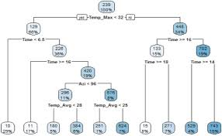
Method
Sherlyn
CART shows how the value of a target variable is predicted based on the value of other variables
Grow tree to the maximum
Prune to obtain the optimal decision tree

Slide 36
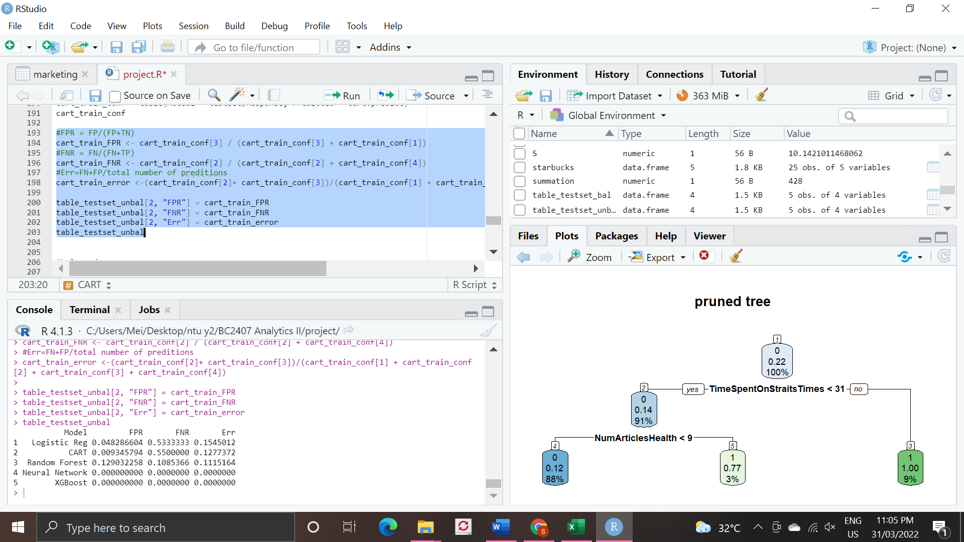
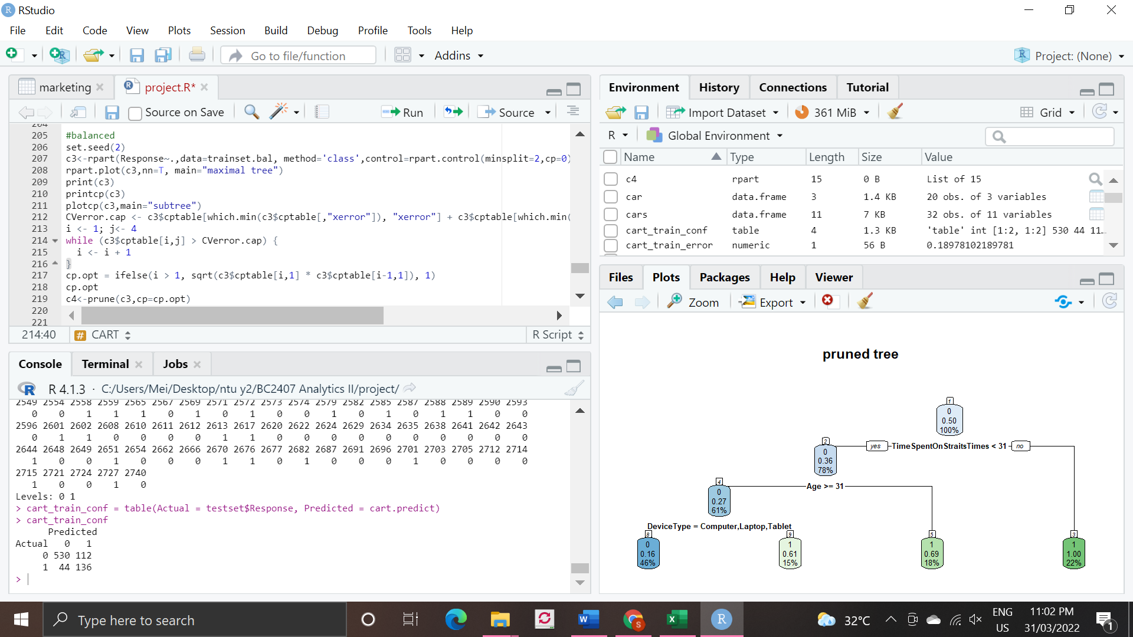
Decision tree
Unbalanced Trainset
Balanced Trainset
Sherlyn

Slide 37
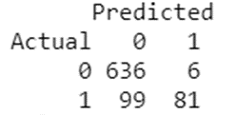
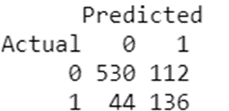
Confusion matrix and errors
Unbalanced Trainset
Balanced Trainset
Sherlyn
Dataset | FPR | FNR | Err
Unbalanced | 0.009 | 0.550 | 0.128
Balanced | 0.238 | 0.127 | 0.214

Slide 38
Random Forest
5.5

Slide 39
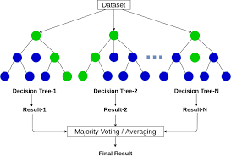
Method
Sherlyn
The random forest algorithm creates predictions by creating and combining multiple decision trees using Bagging
Can be used to obtain variable importance of variables, ranked in order of importance
Analysis performed both on balanced and unbalanced trainset

Slide 40
Trend of errors
Sherlyn
Dataset | FPR | FNR | Err
Unbalanced | 0.031 | 0.461 | 0.125
Balanced | 0.151 | 0.122 | 0.145
For RF, we observe that the model trained on a balanced data set will see a an increase in FPR and significant decrease in FNR
Error rate is also expected to increase slightly with a balanced data set though not very significant
Based on this result, Random Forest currently produces the most optimal result

Slide 41
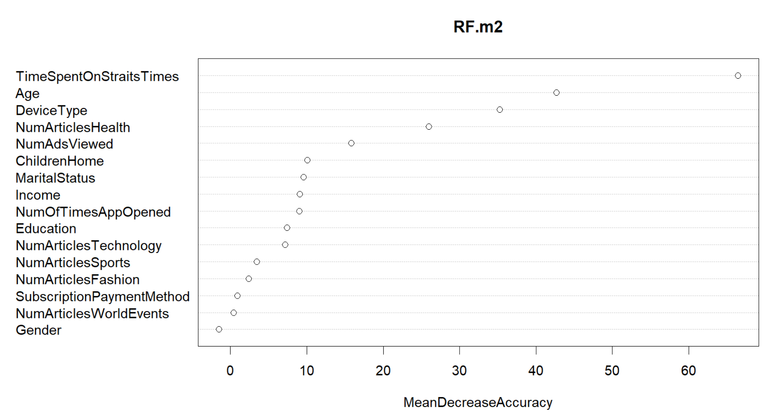
Variable Importance
Sherlyn
Top 8 most important variables

Slide 42
Neural Network
5.6

Slide 43

What is a Neural Network (NN)
Yi Xuan
Regression
Classification

Slide 44
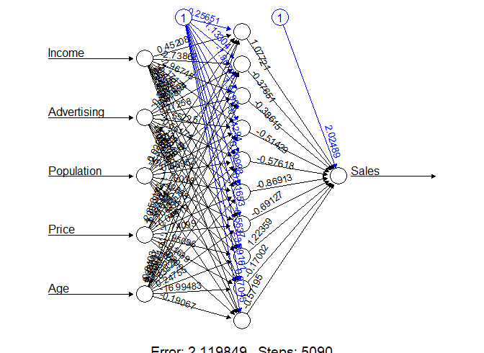
Data Preparation
Yi Xuan
Using R’s “neuralnet” library
Able to plot neural diagram
Unable to handle categorical variables

Slide 45
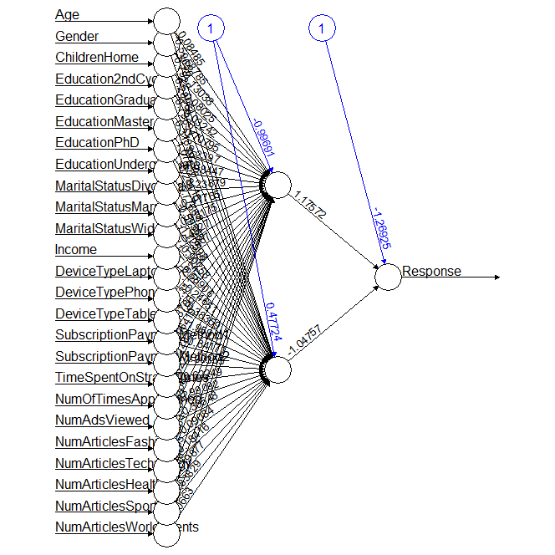
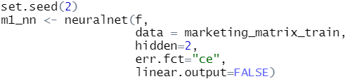
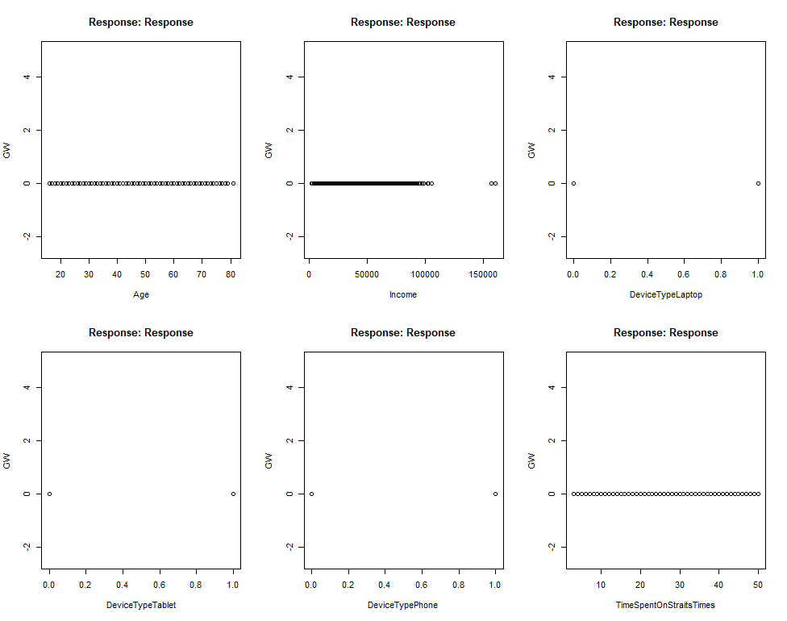
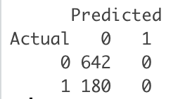
Training on Unbalanced Dataset
Yi Xuan
A. Default Settings (Without Normalization)
GW plot against response
Confusion Matrix

Slide 46

Training on Unbalanced Dataset
Yi Xuan
B. Normalization with different # of neurons
Perform MIN-MAX Normalization
Finding optimal # of neurons in a layer
1 to 2 hidden layers
Optimal # of neurons in a layer:

Slide 47
Finding optimal # of nodes (Unbalanced)
Yi Xuan
Model | FPR | FNR | Err
Without Norm | 0 | 1 | 0.219
Norm 10 Nodes | 0.125 | 0.456 | 0.197
Norm 8 Nodes | 0.114 | 0.406 | 0.178
Norm 4 Nodes | 0.069 | 0.417 | 0.145
Norm 3 Nodes | 0.008 | 0.622 | 0.142
Norm 2 Nodes | 0.009 | 0.617 | 0.142

Slide 48
Training on Balanced Dataset
Yi Xuan
A. Comparison between NN model trained on balanced dataset
Vs
NN model trained on balanced dataset + Top 8 Variables used from RF
Model | FPR | FNR | Err
NN Balanced | 0.252 | 0.139 | 0.227
NN Balanced + VarImpt from RF | 0.229 | 0.117 | 0.204

Slide 49
Finding optimal # of nodes (Balanced)
Yi Xuan
Model | FPR | FNR | Err
Norm 10 Nodes | 0.206 | 0.222 | 0.209
Norm 8 Nodes | 0.226 | 0.239 | 0.229
Norm 4 Nodes | 0.206 | 0.228 | 0.210
Norm 3 Nodes | 0.123 | 0.356 | 0.174
Norm 2 Nodes | 0.218 | 0.144 | 0.202

Slide 50
XGBoost
5.7

Slide 51
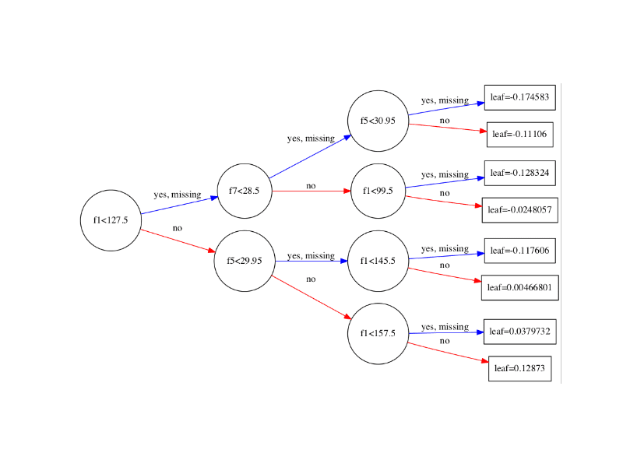
What is XGBoost?
Regression
Classification

Slide 52
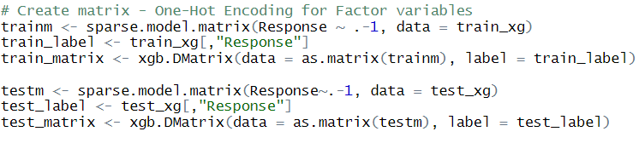
Data Preparation
Yi Xuan
XGBoost is unable to handle categorical variables
Convert categorical variables to numeric using matrix

Slide 53
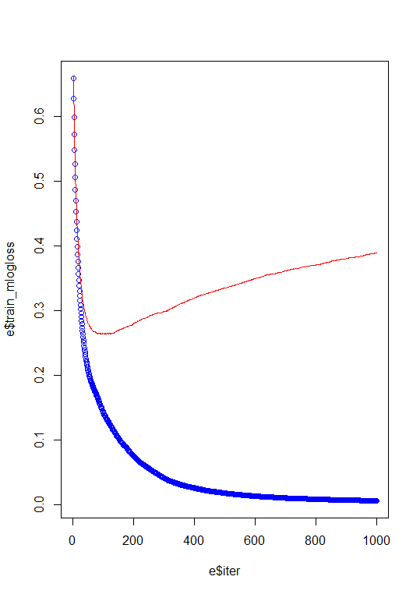
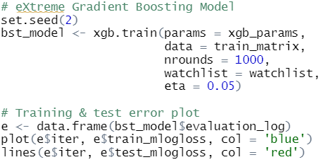
Training on Unbalanced Dataset
Yi Xuan
A. Default Settings

Slide 54
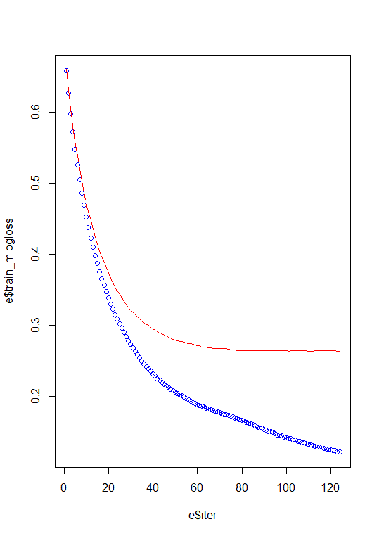
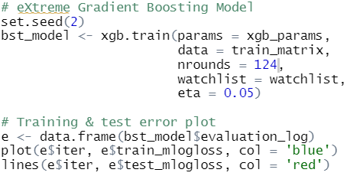
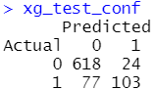
Training on Unbalanced Dataset
Yi Xuan
A. Default Settings
Confusion Matrix

Slide 55
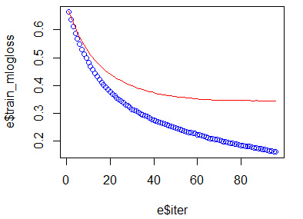
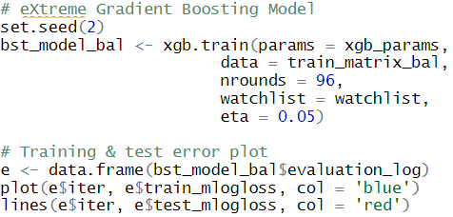
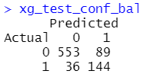
Training on Balanced Dataset
Yi Xuan
A. Default Settings
Confusion Matrix
Model | FPR | FNR | Err
Unbalanced | 0.037 | 0.428 | 0.123
Balanced | 0.139 | 0.200 | 0.152

Slide 56
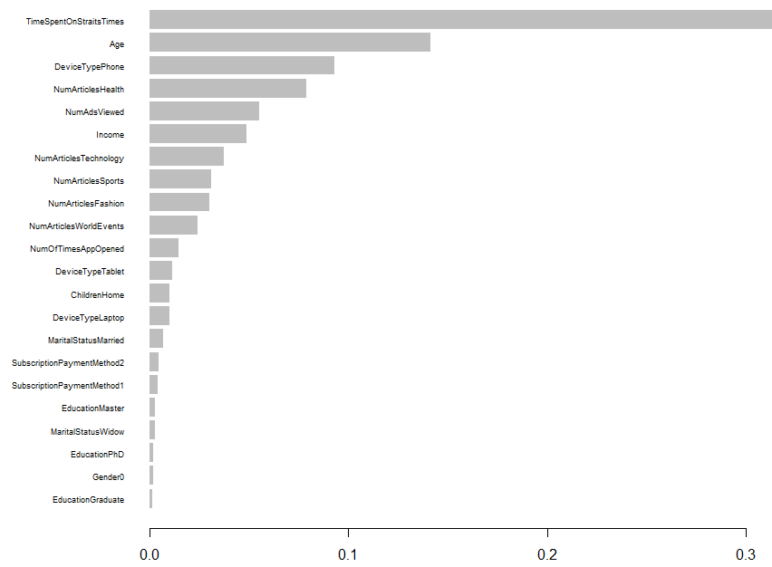
Variable Importance
Yi Xuan
Time Spent on Straits Times
Age
Device Type
Number of Health Articles Read
Number of Ads Viewed
Income

Slide 57
Model Recommendation
5.8

Slide 58




Understanding FPR, FNR, Err
False Positives
False Negatives
Misclassification
Yi Xuan
Indicates an inherent weakness
Loss of revenue
Indicates how effective the market was captured
Loss of revenue
Describes the overall predictive power and accuracy of the model

Slide 59
Determining the relevant metrics
Yi Xuan
Assume:
Both FNR and FPR: 10%
Revenue earned per click: $1
Effects of Group Sizes on FPR and FNR
GROUP 1: Readers that are predicted to click on the advertisement
GROUP 0: Readers that are predicted to NOT click on the advertisement
GROUP 1
100 Readers
Revenue: $90
GROUP 2
10 Readers
Loss of Revenue: $1
Before:
Before:
FPR: 20%
FNR: 20%
After:
$10
After:
$1
100 Readers
Revenue: $80
100 Readers
Loss of Revenue: $2

Slide 60
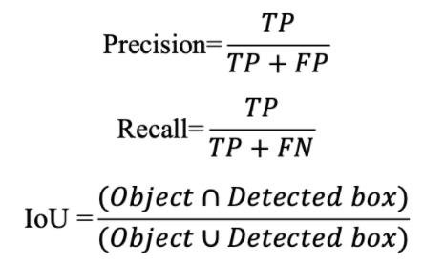
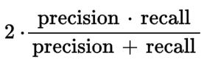
Determining the relevant metrics
Precision
Recall
F1-Score
Yi Xuan
Out of all the responses predicted, how many actually responded
Out of all the actual responses, how many did we capture as responded
Used when both Precision and Recall are equally important

Slide 61

Comparison of Metrics
Yi Xuan
Model |  | FPR | FNR | Err | F1-Score
Unbalanced | Log Reg (BE) | 0.048 | 0.533 | 0.155 | 0.569
 | CART | 0.009 | 0.550 | 0.128 | 0.607
 | RF | 0.031 | 0.461 | 0.125 | 0.653
 | NN | 0.069 | 0.417 | 0.125 | 0.638
 | XGBoost | 0.0.037 | 0.428 | 0.123 | 0.671
Balanced | Log Reg (BE) | 0.176 | 0.206 | 0.183 | 0.656
 | CART | 0.238 | 0.128 | 0.214 | 0.641
 | RF | 0.151 | 0.122 | 0.145 | 0.726
 | NN | 0.218 | 0.144 | 0.202 | 0.650
 | XGBoost | 0.139 | 0.200 | 0.152 | 0.697

Slide 62
Model Considerations
Yi Xuan
Straits Times Requirements | Neural Network | Random Forest
Predictions required on the fly | Algorithm takes a substantial amount of time to run | Relatively fast
Large amount of predictions required |  | Able to handle large datasets
May not have the capacity to tune or clean the data | Many hyperparameters that are required to be tuned | Parameters may not require much tuning
Robust, reliable and applicable to many advertisers | Very reliant on input data | Low risk of overfitting
Classification problem | Can be used for classification | Has one of the best accuracies

Slide 63
06
Implementation Strategy

Slide 64

Existing Pool of Advertisers
Roshan
Currently, a large pool of advertisers exists from the hard copy newspapers and epaper
A free trial can be offered to these advertisers to join and showcase the effectiveness of the model

Slide 65
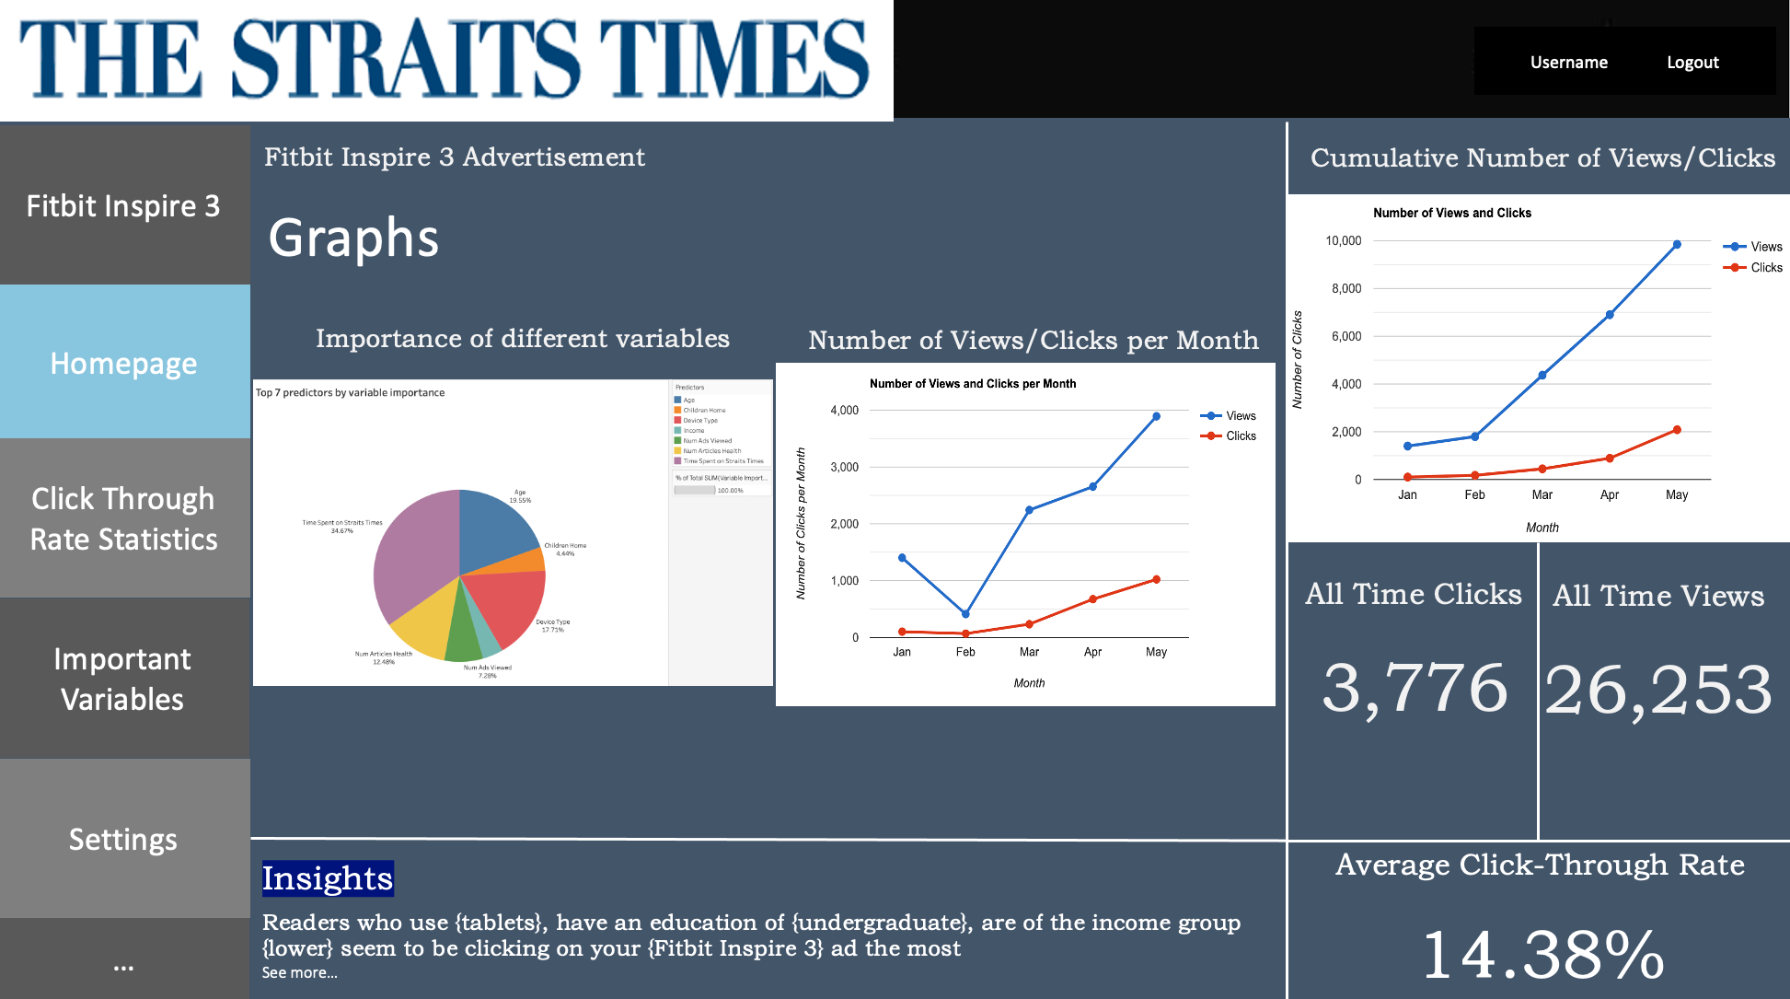
Straits Times Adsense
Roshan

Slide 66
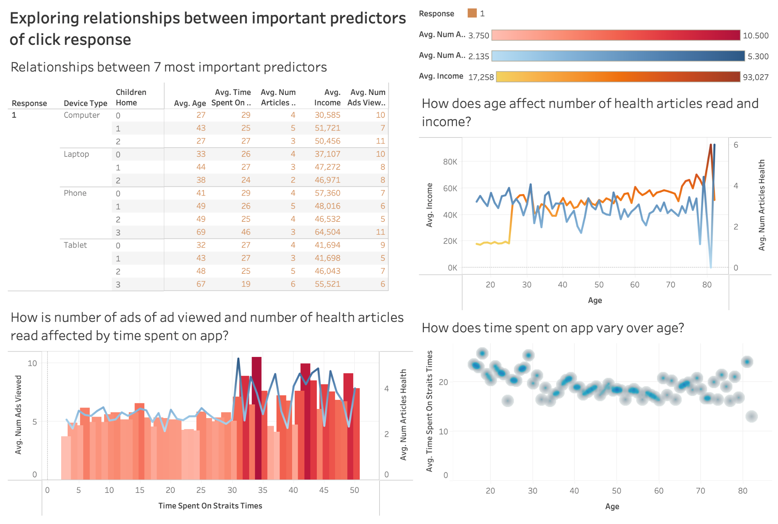
Interactive
Dashboards
Roshan
Live Demo on Tableau

Slide 67
07
Evaluating success

Slide 68



Measuring Success
Click-through Rates
Profits
Number of
Advertisers
Roshan
Click through rate expected to be higher than the average of 50-70%
Extra profit expected to be earned due to no commission fees
Expected increasing trend of advertisers using Straits Times Adsense over the long run

Slide 69
08
Conclusion

Slide 70

Future Improvements
Roshan
Constantly train the model on new data & run the model for a wide range of advertisers

Slide 71
THANK YOU!

